Slide 1

HIMALAYAN WHITEHOUSE INTERNATIONAL COLLEGE
(Affiliated to Purbanchal University)
Our Final project presentation on
“STUDENT RECORD MANAGEMENT SYSTEM”
Submitted By:
Ishwor Pokharel
Ayuscal Sedhai
Dharmaraj Patherkat
Submitted To:
THE DEPARTMENT OF SCIENCE AND TECHNOLOGY

Slide 2
CONTENTS
Introduction
Objectives
Problem Statement
Scope
Selected SDLC Model
One Level DFD
Activity Diagram
ER Diagram
Implementation & Testing
Conclusion & Future Enhancement
References

Slide 3
INTRODUCTION
SRMS is a software application designed for educational institutions.
It was built using Java and SQL for secure and efficient student record management.
Exclusively for administrative use with a secure login system.
Reduces manual record-keeping efforts, improves accuracy, and enhances data security.

Slide 4
Objectives
To develop a secure login system for administrators.
To enable efficient student record management (Add, View, Edit, Search, Delete).
To automate fee structure management.
To provide result management functionality.

Slide 5
Problem statement
Manual record-keeping is time-consuming and error-prone.
Difficulties in managing registration, fee payments, and academic records.
Data inconsistencies and security risks.
SRMS provides an automated solution for efficient student data management.

Slide 6
Scope
User Authentication: Secure login and signup for admin access.
Student Registration: Store personal, academic, and contact details.
Record Management: Search, update, and delete student records.
Fee Management: Track payments and generate admit cards.
Result Management: Display academic performance records.
User Interface: Developed with Apache NetBeans for better usability.

Slide 7
Selected SDLC Model
Model Chosen: Agile Model
Reason for Selection:
Allows iterative development and continuous feedback.
Adapts to changes and improvements efficiently.
Ensures early detection and resolution of issues.
Enhances collaboration between development and testing teams.
Provides flexibility in incorporating user requirements during development.

Slide 8
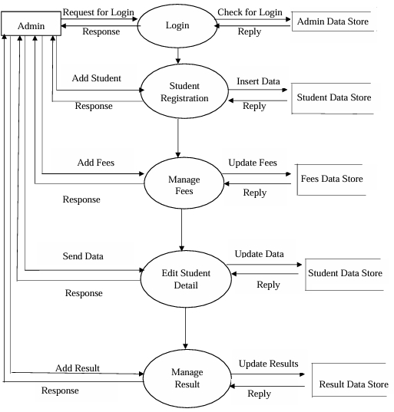
ONE LEVEL DFD

Slide 9
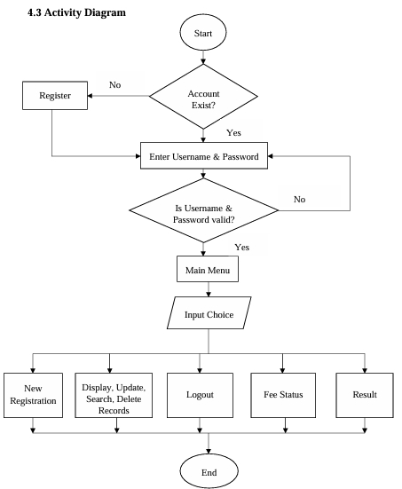
ACTIVITY DIAGRAM

Slide 10
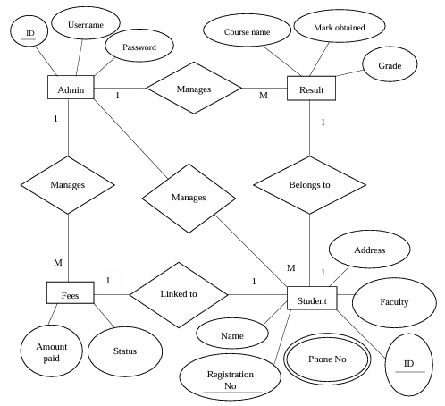
ER DIAGRAM

Slide 11
Implementation & testing
Implementation: Developed using Java, SQL Connector, NetBeans.
Testing: Usability testing, functional testing, database testing.
Successfully tested login, student registration, fee module, result module.

Slide 12
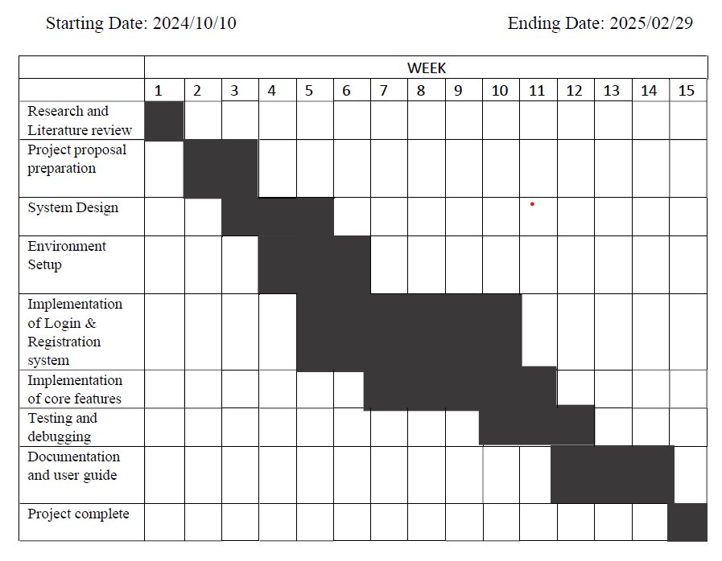
GANTT CHART

Slide 13
Conclusion & future enhancements
The SRMS simplifies student data management.
Provides secure and organized record-keeping.
Future Enhancements:
Adding student access for result viewing.
Mobile application integration.
Cloud-based database for remote access.

Slide 14
REFRENCES
Research Articles
[1] Gupta, A., & Sharma, R. (2020). Web-based student information management system. Journal of Information Systems, 12(3), 123-135.
[2] Khan, M., Ali, S., & Hussain, T. (2019). Desktop-based student management system using SQL database. International Journal of Computer Science, 15(2), 45-52.
[3] Patel, H., & Desai, M. (2021). Java-based applications in educational management: A review. Educational Technology Journal, 18(4), 78-89.

Slide 15
THANK YOU

